Slide 1




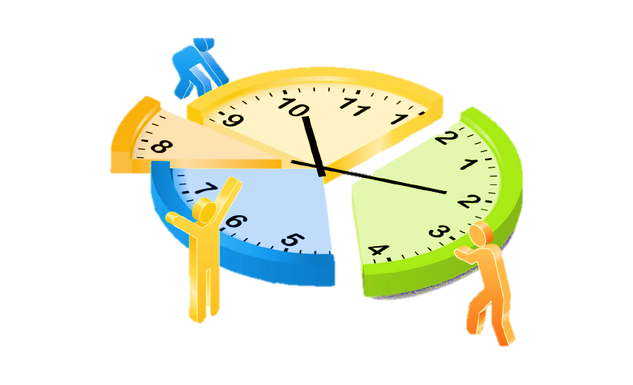
We can’t control time but we can control how we use it.
Once lost, time cannot be gained back again.
TIME MANAGEMENT
What is Time Management?
Communication Skills
Time management is the strategy of planning out your available time and controlling the amount of time you spend on specific tasks in order to work more efficiently.
YOU
CONSTRAINTS
DEMANDS
CHOICES
Why is it important?
Introduction
Time is limited
Accomplish more with less effort
Improved decision-making ability
Reduce stress
Free time is necessary
Self-discipline is valuable
Effective time management allows individuals to assign a specific time to activities as per their importance.
BY
Sonia Mascarenhas
Chahel Gupta
Aneri Patel
Amishi Desai
Reneeka Nadkarni
People with good time management strategies are more likely to carry out each stage efficiently and effectively, resulting in high productivity and good quality work.
https://elearningindustry.com/time-management-in-online-learning-importance
https://books.google.co.in/books/about/Eat_That_Frog.html?id=nJiqDgAAQBAJ&printsec=frontcover&source=kp_read_button&redir_esc=y
https://www.appointmentplus.com/blog/why-time-management-is-important/

Slide 2
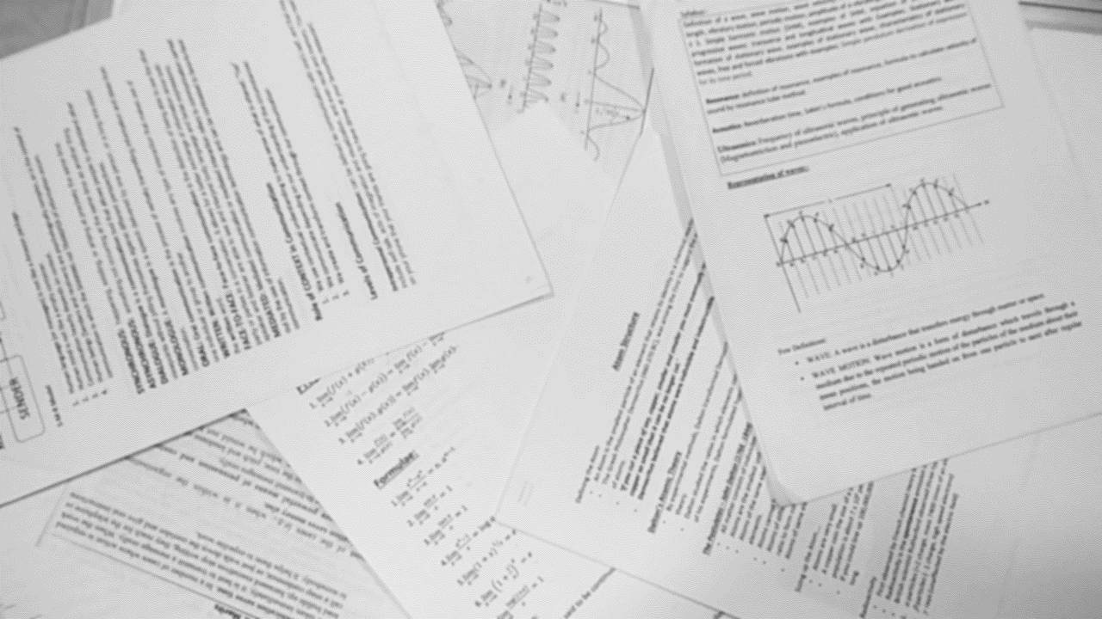



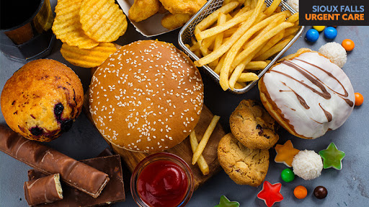
Lack of Time Management
Procrastination
Lower grades and test scores
Chronic lack of sleep
Unhealthy eating habits

Slide 3
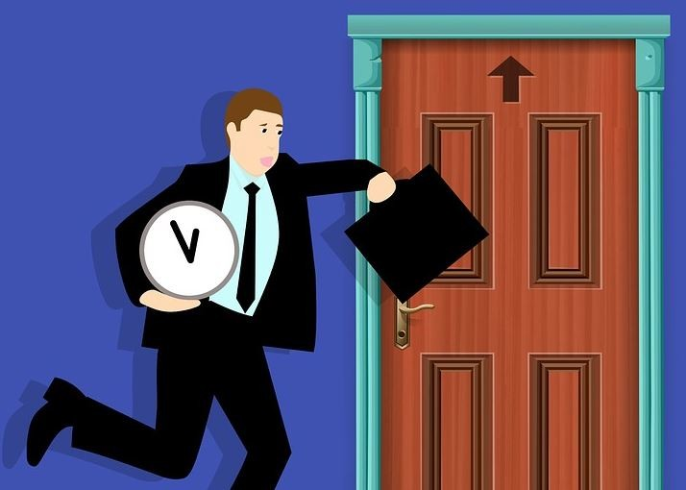

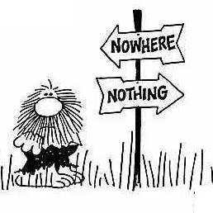
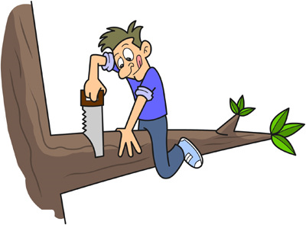
Lack of punctuality
Too much involved in Social Media
Don’t know our main Goal
Improper planning
https://magoosh.com/blog/what-are-the-effects-of-poor-time-management/

Slide 4


Tips and Tricks to Manage Time
PPT Concept
P- Plan
Plan your whole day
Make a To-Do list
P-Prioritize
Decide which tasks are more important
Follow the 4 Quadrant prioritize To-Do list
The best quadrant is the 2nd one
T-Time Lines
In the to-do list divide all the task according to the time
 | Due soon | Not due soon
Important | 1 | 2
Not Important | 3 | 4

Slide 5

2. 6D Information Management System
6D- Deter
1D- Discard
5D- Drawer
2D- Deligate
4D- Do
3D- Date

Slide 6
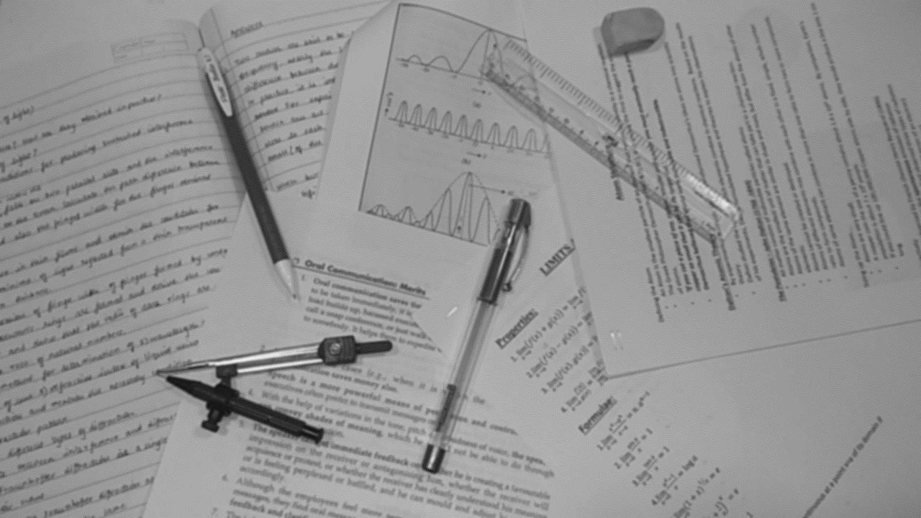






Some more ways to manage time efficiently
Be more mindful of screen time to reduce distractions.
Make a list for each day to try to complete one creative task, find a place to contribute/help and stay connected in a socially distanced world. (articles, documentaries, relations)
Do one thing at a time.
Prioritise what is important and needs to be done first.
Note down tasks.
When making a timetable try to spread out work evenly.
https://salsamobi.com/how-to-maintain-effective-time-management-during-the-covid-19-crisis/
https://thriveglobal.com/stories/time-management-unexpected-lessons-work-from-home-tips/

Slide 7
THANK YOU!

